Slide 1

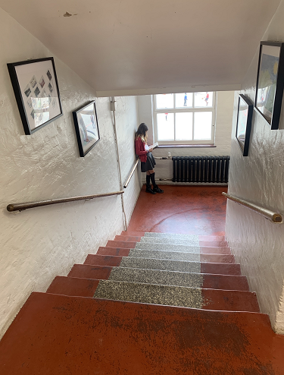




Welcome to Year 6
2024-25

Slide 2
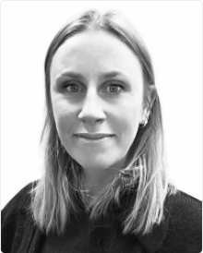
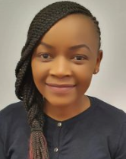
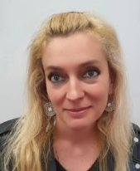
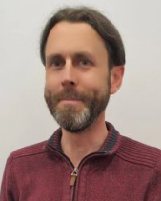
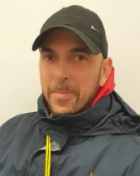
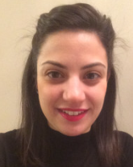
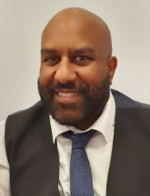
Staff working with your child in Y6
Eagles – Ms Gedny
Hawks – Miss Kepha
Specialist Maths Teacher – Ms Aneta
Music Teacher – Mr O’Flynn
PE Coaches – Mr Simon & Mr Simeon
Spanish Teacher – Miss Alonso
SENDCO – Mr Dharma
Head of Phase – Ms Kepha

Slide 3
What we will cover today:
New routines
Supporting your child at home
1
4
Secondary Transfers
5
APEX Learning
2
Trips
6
3
CATs/SATs Tests
7
Q & A

Slide 4
New routine
1
Study start from 8:45
1st break 10:20-10:35, 2nd break 11:35-11:50, lunch 1:00-2:00pm
Home alone or collection 3:30pm
Wellbeing – good night’s sleep, healthy breakfast
Website – Updated with important information
P.E. Wednesdays (arrive at school in uniform)
Uniform (black shoes, trousers, shirt, tie, jumper, blazer
Reading Records
Weekly Spellings
Daily TTRS practise

Slide 5
Secondary Transfers
2
IMPORTANT DATES:
Deadline for Secondary school application.
(Thursday 31st October)
Year 7 application is open on 1.09.2024
You should apply by 31 October 2024
If you need support – email admin@blossom.hackney.sch.uk and
mark FAO Ms Kepha
Top Tips:
Apply on time
Be realistic
Order of preference matters (but secondary schools won’t see it)
Visit school’s websites
https://www.learningtrust.co.uk
https://education.hackney.gov.uk/sites/default/files/document/secondary-admission-leaflet.pdf
Secondary Application Workshop questionnaire

Slide 6
CATs and SATs Tests
3
- These are Cognitive Ability Tests
They exist in order to make the secondary allocation process as fair as possible.
Children will be sorted into 4 bands and secondary schools must then allocate places choosing children equally from these bands*
100 children admitted to secondary school
- There are 3 tests: Verbal, Quantitative and Non-Verbal.
- They are all done in school, one after the other, electronically

Slide 7
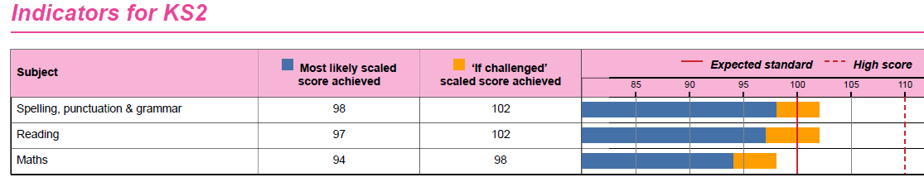
CATs and bands
3
A
B
C
D
25 children
25 children
25 children
25 children
*100 children admitted to secondary school
If a child does not sit the CATs tests then they will be placed at the bottom of the list in terms of allocations for secondary schools (even if you apply to secondary schools on time)
Hackney schools are expected to hold the CATs test between Monday 23rd September to Friday 11th October 2024.
We will send a text with the exact date our children will be sitting the test.

Slide 8
SATs 2025
3
Monday 12th May – Thursday 15th May 2025
Monday – Spelling/Grammar (GPS)
Tuesday – Reading
Wednesday – Maths Paper 1 and Paper 2
Thursday – Maths Paper 3
Friday – Day out
We will have another parent meeting in Spring to go through how you can help in more detail.
Right now we want your children to focus on school work, settling in to year 6 and enjoying themselves.

Slide 9



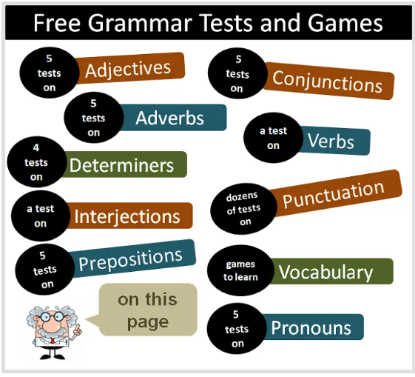


Supporting Your Child at Home
4
Reading
Year 6 weekly home learning
Weekly spellings test
Maths
www.grammar-monster.com

Slide 10
Supporting Your Child with maths
4
Timestable Rockstars
- Arithmetic challenges (Hit the button is a great resource)
- Ask your children to help you cook, shop or help around the house (maths is everywhere)
BBC Bitesize
Khan academy has great resources
Your child will also get home learning from us.

Slide 11
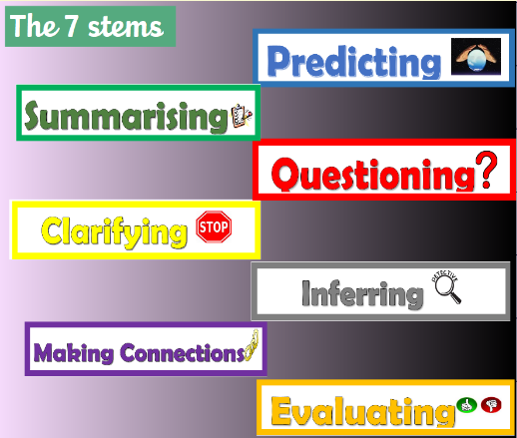
Supporting Your Child - Reading
4
Bring reading records and reading books in everyday
- Complete reading records with daily reading stem
Book bands
Encourage reading for pleasure – News paper, magazines
Read to your children, have your children read to you - anywhere, anytime.
- Encourage independent reading - Every day for 30 mins
- Ask them what they are reading/what is it about

Slide 12
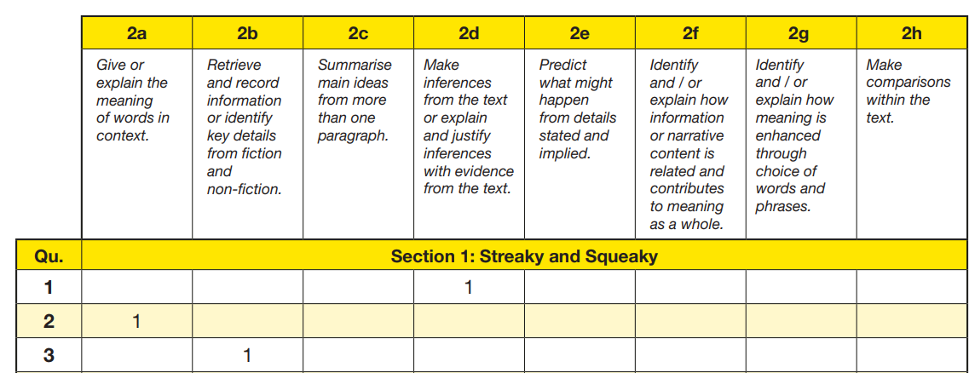
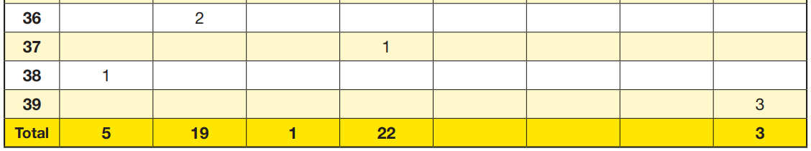
Supporting Your Child – Reading
4

Slide 13

APEX Learning
5
£19 per session
Each session lasts 1hr 45mins
Runs on Wednesdays at the school
Call the number for more info

Slide 14
Not only the Lowest 30%
5
As part of our ongoing school development, we have a big focus on children who fall into the lowest 30% in terms of attainment
This is because we regularly achieve around 70% in end of year assessments (maths, reading, and writing)
We want to improve that, and so your child may be invited to boosters, interventions, or may receive homework in order to help them achieve the expected standard
Having said that, we want all children to make progress, and so your child may be invited to a booster or intervention, even if they do not fall into that lowest 30%
If you are unsure, ask us, we will always be open and transparent about your child’s attainment

Slide 15

Trips – Parents Volunteers
6
We will be going on more trips this year!
There will be a trip at least every half term.
We will need your help as Parent Volunteers
We will send out a letter with a QR where you can let us know if there are days when you can help

Slide 16

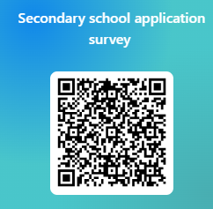
Q & A
7
If you need support with anything, please do let us know

Slide 17

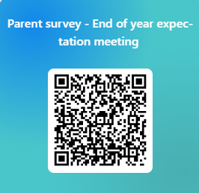
Parent Survey
Thank you for coming.
We are always here to help

